Slide 1


Exploring the dataset generated by Tara Ocean project using R Studio
‘Omics and Bioinformatics Workshop
MarLina Laboratory, Silliman University
May 28 – June 11, 2019
Christopher Valdez and Gericho Soriano
University of Santo Tomas Graduate School

Slide 2
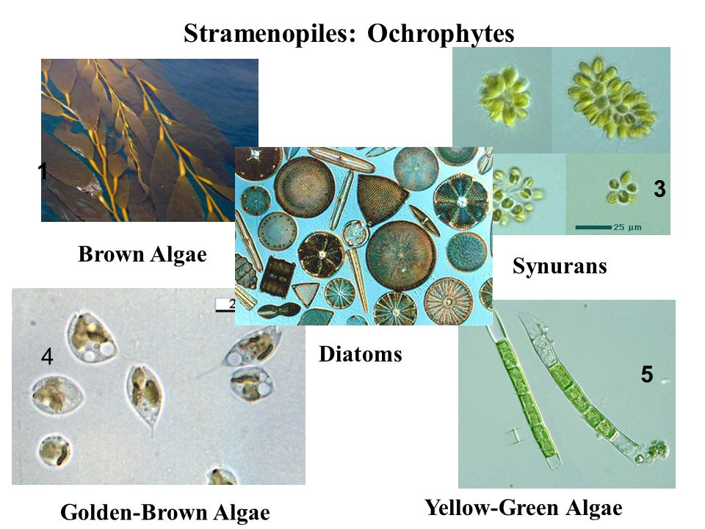
The stramenopiles
are a major line of eukaryotes.
Most are algae, ranging from the giant multicellular kelp to the unicellular diatoms, which are a primary component of plankton.
Reference: www.fondriest.com
Notes:
Diatoms, considered one of the most diverse and ecologically important phytoplanktonic groups, contribute around 20% of global primary productivity. They are particularly abundant in nutrient-rich coastal ecosystems and at high latitudes. Here, we have explored the dataset generated by Tara Oceans from a wide range of oceanic regions to characterize diatom diversity patterns on a global scale.

Slide 3
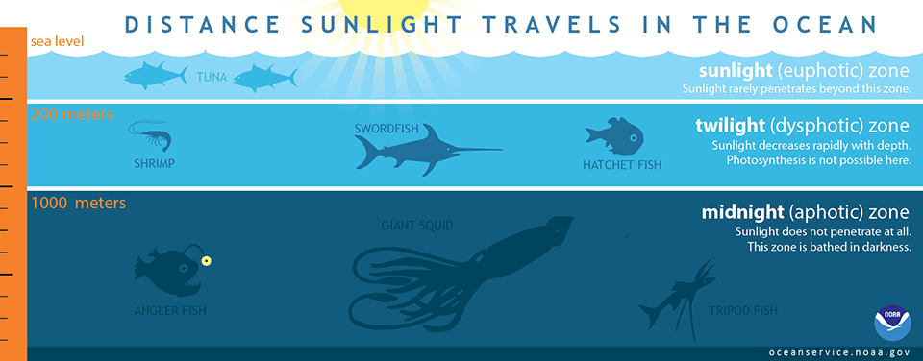
3 – 6 meters deep Subsurface
17 – 120 meters Deep Maximum Chlorophyll (DCM)
Reference: https://oceanservice.noaa.gov/facts/light_travel.html
Notes:
Underwater Photosynthesis
Phytoplankton drifting about below the surface of the water still carry out photosynthesis. This process can occur as long as enough light is available for the chlorophyll and other pigments to absorb. In the ocean, light can reach as far as 200m below the surface ²⁵. This region where sunlight can reach is known as the euphotic zone. Phytoplankton and other algae can be found throughout this zone.
DCM
SUR

Slide 4
Research Question
In which part of the world has the highest concentration of photosynthetic diatoms?
At what depth of ocean level are the diatoms more abundant?

Slide 5

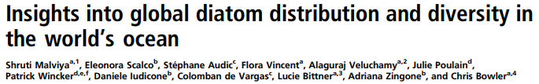
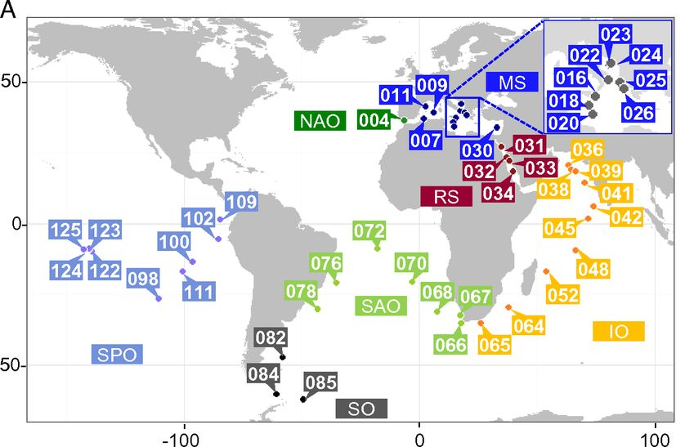
Data Grouping
2016
EUROPEAN
004 - 034
INDIAN
036 - 065
ATLANTIC
066 - 085
PACIFIC
100 - 125
Reference: https://doi.org/10.1073/pnas.1509523113

Slide 6
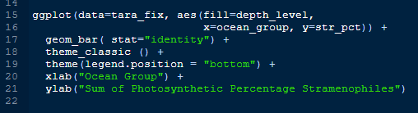
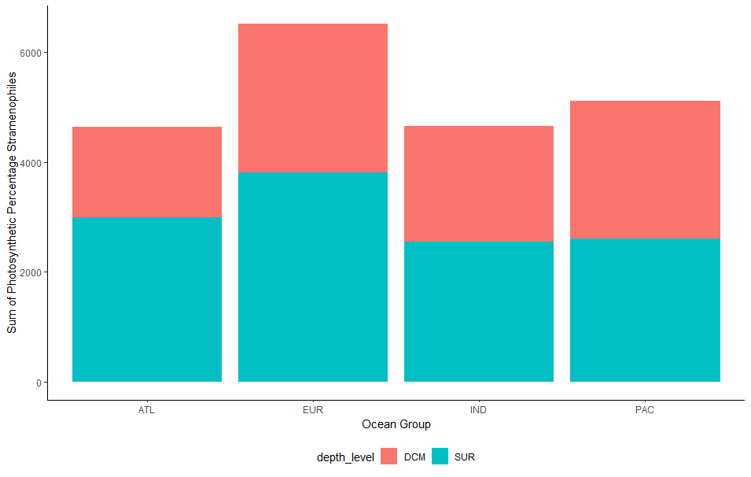
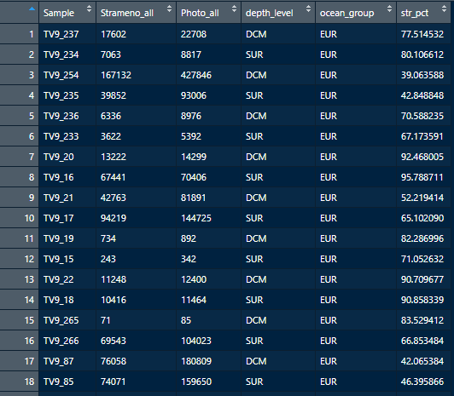

Slide 7
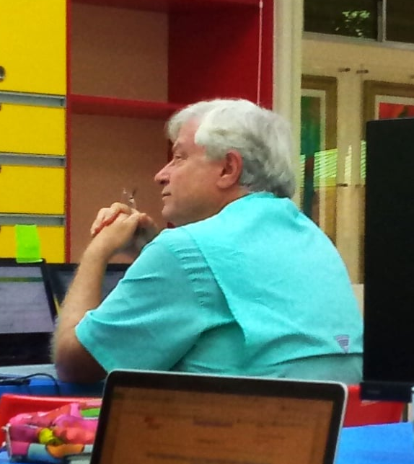
Thank you for listening!
“There is always joy in learning something new.”

